Slide 1
CHAPTER-9 Multimedia Application

Slide 2
Contents:
Video-on-demand
Video Conferencing
Education application and Industrial application
Information system
Multimedia archives & Digital libraries
Media editors

Slide 3
9.1 Video-On Demand (VoD)
It is an interactive multimedia system that works like cable Television, the difference being that the customer can select a movie from a large video database.
It is a programming system which allows users to select and watch/listen to video or audio content such as movies and TV shows whenever they choose, rather than at a scheduled broadcast time, the method that prevailed with over-the-air programming during the 20th century.
Individual customers in an area are able to watch different programmers when they wish to, making the system a realization of the video rental shop brought into the home.
Video on demand (VoD) is an interactive TV technology that allows subscribers to view programming in real time or download programs and view them later.
VoD can work well over a wide geographic region or on a satellite-based network as long as the demand for programming is modest.

Slide 4
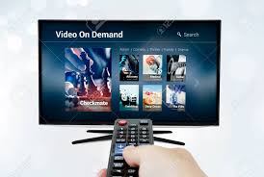
Television VOD systems can stream content through either a set-top box, a computer or other device, allowing viewing in real time, or download it to a device such as a computer, digital video recorder (also called a personal video recorder) or portable media player for viewing at any time.

Slide 5
9.2 Video Conferencing
Videoconferencing is a live, interactive, two-way audio/video connection between two or more physically separated locations. Videoconferencing can be a great alternative to in-person meetings, reducing both travel time and expenses.
It means to conduct a conference between two or more participants at different sites by using computer networks to transmit audio and video data.
UC videoconference systems provide users with a full range of capabilities, including:
Full motion video
Graphics
Audio
VCR/DVD playback and recording
Integrated computer-based presentations
Multi-point presence

Slide 6
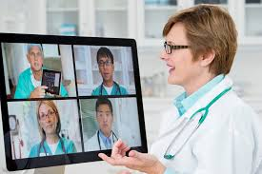
Fig: Example of Video Conferencing
Advantages: ??

Slide 7
9.3 Education Application, Industrial Application
Education Application:
In Education, multimedia is used to produce computer-based training courses (popularly called CBTs) and reference books like encyclopedia and almanacs.
A CBT lets the user go through a series of presentations, text about a particular topic, and associated illustrations in various information formats.
Edutainment is the combination of education with entertainment, especially multimedia entertainment.
Uses:
Slides, E-book, Online information(pdf & videos), advertisement. Etc.
Notes:
an annual calendar containing important dates and statistical information such as astronomical data and tide tables:

Slide 8
Industry Application:
In the Industrial sector, multimedia is used as a way to help present information to shareholders, superiors and coworkers.
Multimedia is also helpful for providing employee training, advertising and selling products all over the world via virtually unlimited web-based technology.
Uses:
Advertisement
Graph and multimedia information , etc.

Slide 9
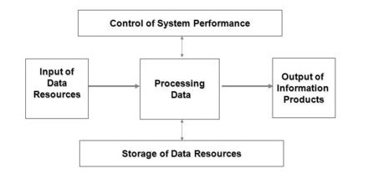
9.4 Information System
An information system (IS) is an organized system for the collection, organization, storage and communication of information.
It is an integrated set of components for collecting, storing, and processing data and for providing information, knowledge, and digital products.
Fig: Information System

Slide 10
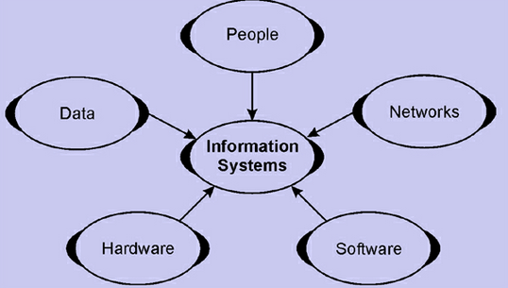

Slide 11
Multimedia Information System
It is a repository for all types of information object. In the computing context, this means all types of digitally represent able data such as text, images and voice. Such systems are complex and multi-disciplinary in nature.

Slide 12
Multimedia Archives
The Multimedia Archives contain the non-textual archives of the Special Collections Department of the J. Willard Marriott Library, University of Utah.
The holdings are divided into two sections:
Photographs
Audio-Visual materials.
Goals:
Expand access to the library’s unique photographic resources
Make a significant contribution to web culture
Represent the contents of the individual photo collection
Allow for wider viewing of fragile photos without the need for them to be physically handled.

Slide 13
Digital Libraries
A digital library, digital repository, or digital collection, is an online database of digital objects that can include text, still images, audio, video, or other digital media formats.
A digital library is a collection of documents in organized electronic form, available on the Internet or on CD-ROM .
Depending on the specific library, a user may be able to access magazine articles, books, papers, images, sound files, and videos.

Slide 14
Features of digital libraries:
No physical boundary
Round the clock availability: 24/7 access to the information.
Multiple access. The same resources can be used simultaneously by a number of institutions and patrons.
Information retrieval
Preservation and conservation
Space
Added value: Digitization can enhance legibility and remove visible flaws such as stains and discoloration.
Easily accessible.

Slide 15
Types of digital libraries
Institutional repositories
Many academic libraries are actively involved in building institutional repositories of the institution's books, papers, theses, and other works which can be digitized or were 'born digital'.
Many of these repositories are made available to the general public with few restrictions, in accordance with the goals of open access, in contrast to the publication of research in commercial journals, where the publishers often limit access rights.
Digital archives
"Digital archives" or "online archives" will still generally contain primary sources, but they are likely to be described individually rather than (or in addition to) in groups or collections. Further, because they are digital, their contents are easily reproducible and may indeed have been reproduced from elsewhere.
The Oxford Text Archive is generally considered to be the oldest digital archive of academic physical primary source materials.

Slide 16
Multimedia Editor
It is primarily responsible for managing website- including generating, editing, and uploading content and for enhancing It’s digital presence and outreach.
The role also requires working across the medium of print and video as and when required, & managing corporate social; media profile.
Editing: It is the process of selecting & preparing written, visual, audible & film media used to convey information.
Key Responsibilities:
Day-to-day management of the websites
Contribution and participate in other communication activity, etc.

Slide 17
Some editors:
Text editors (Eg:Leafpad)
Graphics editor (Eg: Photoshop, CorelDraw)
Image editor (Eg: Pixelmator, Photoshop)
Video editor (Eg: iMovie, Adobe Premiere Pro)
Sound editor (Eg: Audacity)
Animation editors (Eg: Lunapic)

